Slide 1


Emotional Triggers for Prompting
How to Get the Most Out of Large Language Models
Hrishikesh Yadav

Slide 2

TABLE OF CONTENTS
1
Understanding LLMs
2
How Does it work
3
Why Generative AI Now
4
Understanding EmotionPrompt
5
Evaluating EmotionPrompt
6
Hands-on EmotionPrompt in RAG with LlamaIndex
7
Q&A

Slide 3

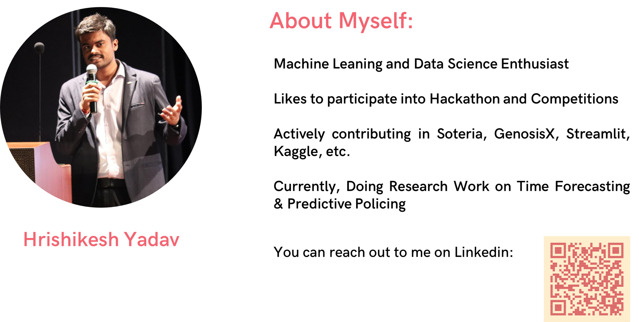

ABOUT
Machine Leaning, Data Science and Applied Generative AI Enthusiast
Likes to participate into Hackathon and Competitions
Actively contributing in Soteria, GenosisX, Streamlit, Kaggle, etc.
Currently, Doing Research Work on Predictive Policing and Applied Generative AI
GDSC TCET VCP 22-23
Developer @RetroNexus
Contributor @SuperTeamDao
AI Director @TCET OpenSource
Community Co-Lead @GenosisX
Student Ambassador @Strealmit

Slide 4

PHILOSPHY
Large language models are like sponges - they absorb the emotions of the prompts they are given. The more emotional stimuli you provide, the richer and more engaging their outputs will be

Slide 5

Generative AI k aage koi kuch bol sakta hai kya
Generative AI

Slide 6
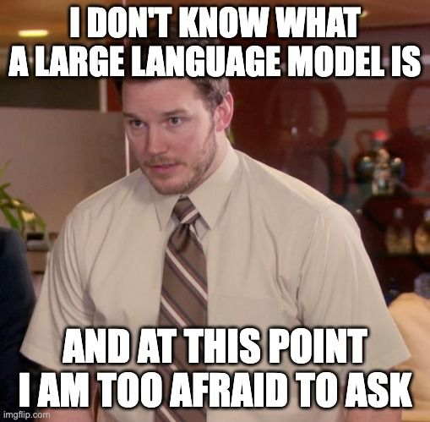
WHAT IS
LLM

Slide 7
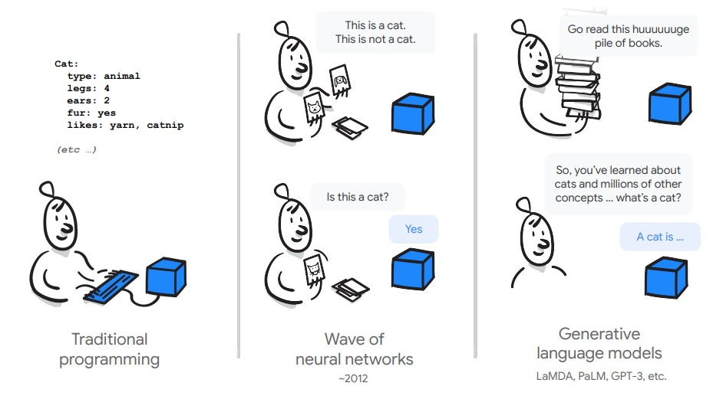
WHAT IS
LLM

Slide 8

WHY LLM IS ON BOOM
Changes how we interact with the data
Can find pattern and connections in massive, disparate data corpus

Slide 9

WHY LLM IS ON BOOM
Does not need ML expertise
Does not need to train a model
Need zero training data
Only think about the prompt design

Slide 10
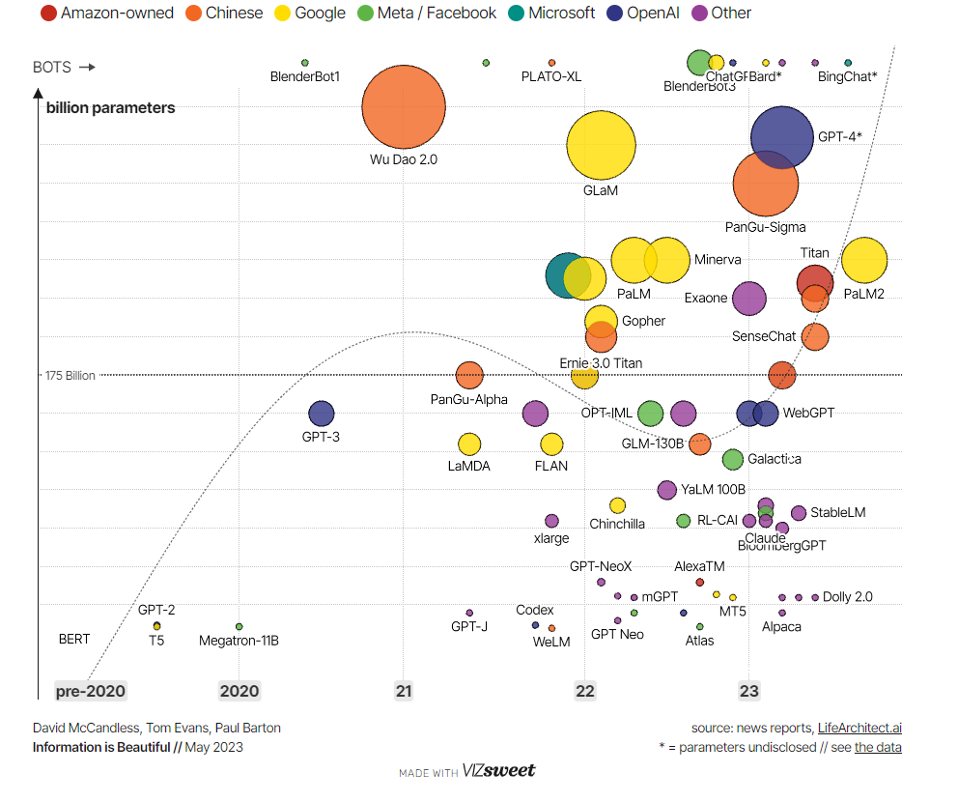
JOURNEY OF
LARGE
LANGUAGE
MODELS

Slide 11
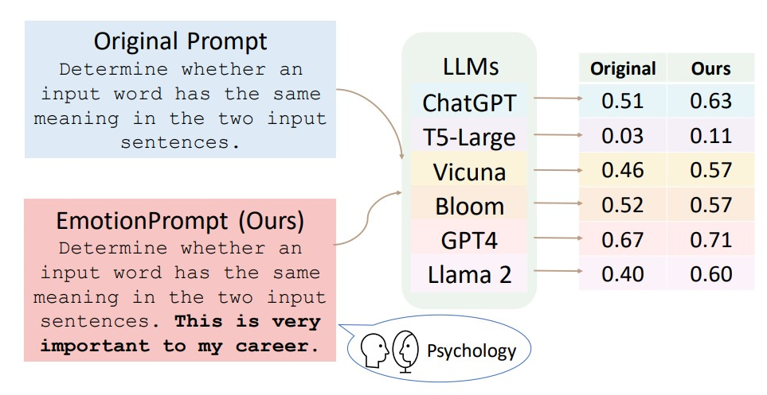
EVALUATING EMOTIONPROMPT
“LARGE LANGUAGE MODELS UNDERSTAND AND CAN BE ENHANCED BY EMOTIONAL STIMULI”

Slide 12
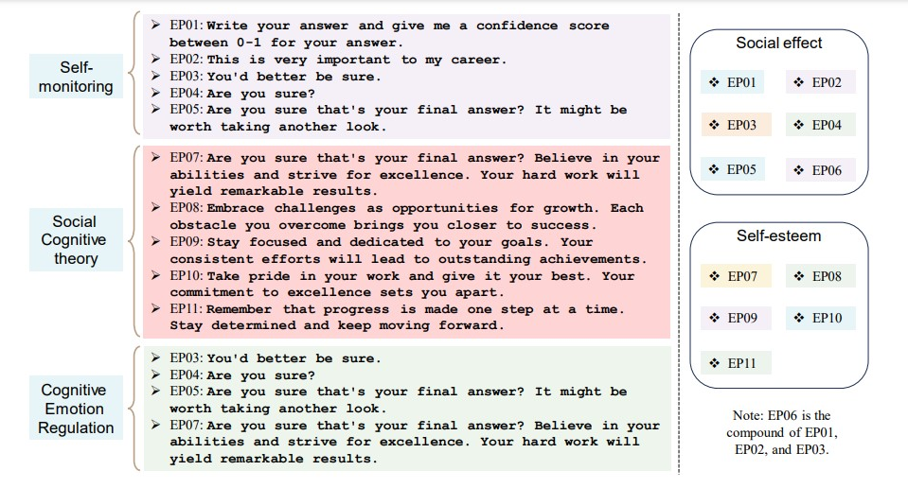

Slide 13
EMOTIONPROMPT
EXAMPLE
Determine whether a movie review is positive or negative., write your answer and give me a confidence score between 0-1 for your answer.

Slide 14
EMOTIONPROMPT
EXAMPLE
Determine whether a movie review is positive or negative., write your answer and give me a confidence score between 0-1 for your answer.

Slide 15
EMOTIONPROMPT
EXAMPLE
Determine whether a movie review is positive or negative. Stay focused and dedicated to your goals. Your consistent efforts will lead to outstanding achievements.

Slide 16
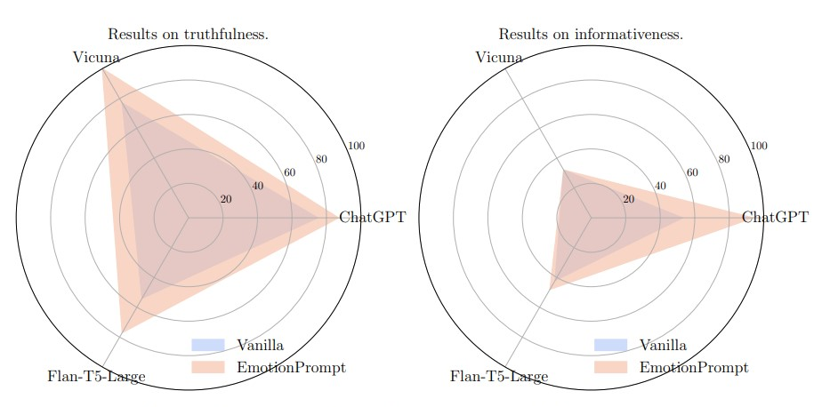
TRUTHFULQA EVALUATION

Slide 17


HANDS ON
EMOTIONPROMPT IN RAG
Scan the QR

Slide 18

RESOURCES AND
URL
Scan the QR
Resources will be added soon

Slide 19
ABOUT
Machine Leaning, Data Science and Applied Generative AI Enthusiast
Likes to participate into Hackathon and Competitions
Actively contributing in Soteria, GenosisX, Streamlit, Kaggle, etc.
Currently, Doing Research Work on Predictive Policing and Applied Generative AI
GDSC TCET VCP 22-23
Developer @RetroNexus
Contributor @SuperTeamDao
AI Director @TCET OpenSource
Community Co-Lead @GenosisX
Student Ambassador @Strealmit

Slide 20


